Slide 1


Sentiment
Analysis using Audio Dataset

Slide 2






Agenda
Understanding SER
Data Augmentation Techniques
Feature Extraction from Audio data
Sentiment Analysis using Audio dataset project
1
5
Applications of SER
2
6
Audio Data Characteristics
Methods of Visualizing audio data
3
7
4

Slide 3
TakeAways
Understanding audio datasets
Feature Extraction using Audio dataset
Audio dataset analysis and preprocessing
Sentiment Analsyis on Audio datasets

Slide 4

Understanding SER
Speech Emotion Recognition, abbreviated as SER, is the act of attempting to recognize human emotion and affective states from speech.
This is capitalizing on the fact that voice often reflects underlying emotion through tone and pitch.
Speech Emotion Recognition (SER) is a branch of computational linguistics and audio signal processing that focuses on identifying and classifying emotions conveyed in a speaker's voice.

Slide 5
Understanding SER
It leverages the idea that emotions influence the tone, pitch, and rhythm of speech, allowing computers to infer the speaker's emotional state.

Slide 6
Applications of SER
Human Computer Interaction
Enhancing the emotional intelligence of virtual assistants (e.g., Alexa, Siri, Google Assistant)
Emotionally responsive AI can improve user experience, retention, and satisfaction.
Example: A virtual assistant detecting user frustration can offer help proactively.

Slide 7


Applications of SER
Customer Experience and Call Centers Real-time emotion analysis in
customer support calls.
Identifying stressed or dissatisfied customers to escalate or redirect calls.
SER helps companies improve service quality and agent performance.
HealthCare and mental Health
Detecting early signs of depression, anxiety, or PTSD from voice recordings.
Monitoring emotional health through daily voice interactions in wellness apps.

Slide 8

Audio data Characteristics
Frequency : The number of cycles (oscillations) of a wave per second. It is measured in Hertz (Hz).
Pitch : The perceived frequency of a sound; it determines how "high" or "low" a sound is. High frequency has higher pitch and low frequency has low pitch. It is measured in Hertz (Hz).
Amplitude : The height of a wave, representing the energy or intensity of the sound. It is expressed in decibels (dB). Aslo referred as sound intensity.
Tone : The quality of a sound determined by its harmonic content.

Slide 9
Audio data Characteristics
Sampling Rate : The number of samples of audio captured per second during digital recording. It is measured in Hertz (Hz) Bit depth : The number of bits used to represent each audio sample.
Noise : An irregular, aperiodic sound with no discernible pitch or pattern.
Duration : The length of the audio signal in seconds.

Slide 10
Methods of visualizing Audio data
Waveform Plot/ Waveplot
A waveplot displays the amplitude of the audio signal over time. It is a time-domain representation.
The x-axis represents time, and the y-axis represents amplitude (loudness).
Shows how the sound's intensity varies over time.
Useful for understanding the overall shape of the audio waveform, such as when loud or quiet sections occur.
It helps identifying silence or noisy sections in audio thereby explaining the dynamics of speech or music.

Slide 11
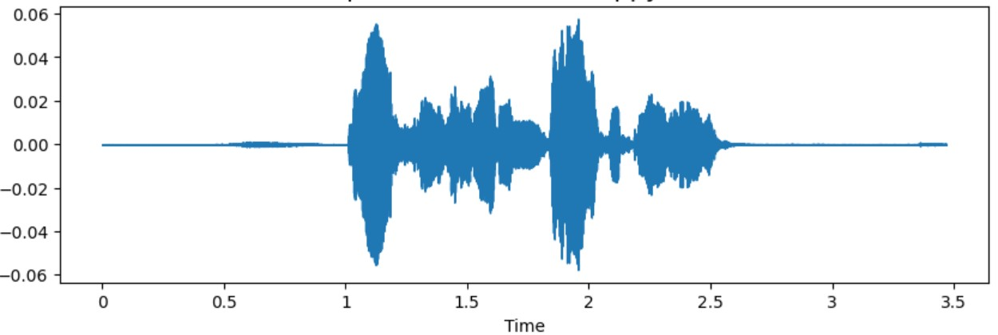
Methods of visualizing Audio data
Sample Waveplot Image

Slide 12
Methods of visualizing Audio data
Spectogram
The frequency content of the audio over time (time vs. frequency with amplitude as color intensity).
The x-axis represents time, the y-axis represents frequency, and the color intensity represents the amplitude (usually in decibels) or energy levels of the frequencies present in the audio signal
It is obtained by applying STFT on the audio dataset and then converting the resultant amplitude to decibels
Displays how different frequencies evolve over time.

Slide 13
Methods of visualizing Audio data
Spectogram
Encodes amplitude information using color (e.g., brighter areas represent higher amplitude).
It helps to analyze pitch and tone in music or speech. It heps identifying patterns in sounds (pitch,tone etc)

Slide 14
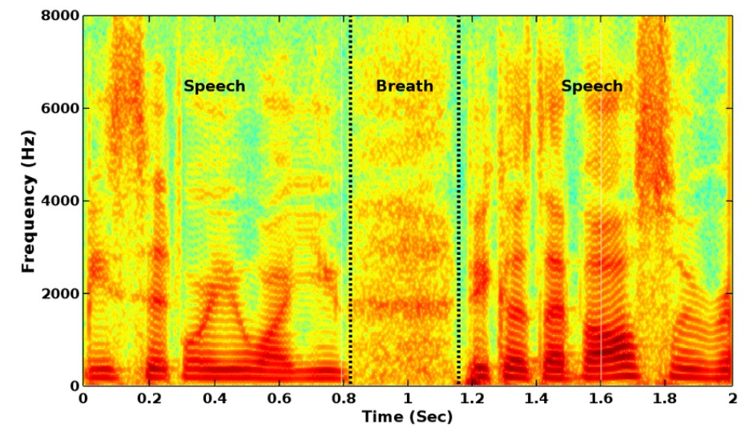
Methods of visualizing Audio data
Sample Spectorgram Image

Slide 15
Methods of visualizing Audio data
Mel Spectogram
A Mel spectrogram is a spectrogram where the frequency axis is transformed into the Mel scale.
It compresses higher frequencies to better match how humans perceive sound.
It transforms a standard spectrogram by applying a non-linear scale known as the Mel scale, which better reflects how humans perceive sound frequencies.

Slide 16
Methods of visualizing Audio data
Mel Spectogram
It is designed such that equal distances on this scale correspond to perceived equal differences in pitch. This contrasts with the linear frequency scale (Hertz), where equal differences in frequency do not correspond to equal perceived differences in pitch.

Slide 17
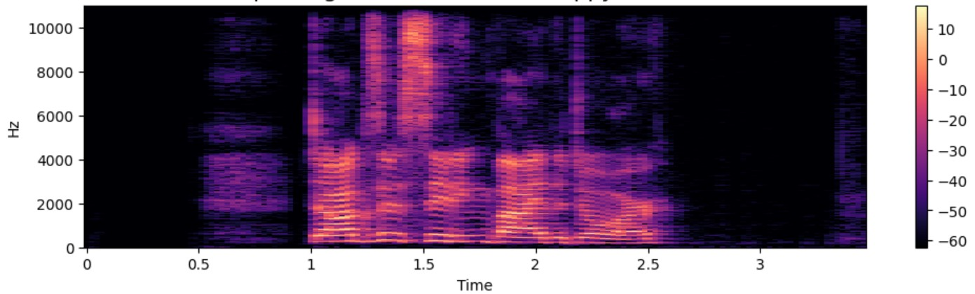
Methods of visualizing Audio data
Mel Spectogram Sample Image

Slide 18
Methods of visualizing Audio data
MFCC - Mel-Frequency Cepstral Coefficients
MFCC) are a crucial feature extraction technique used in audio signal processing, particularly for applications in speech and music analysis, recognition, and classification.
It transforms audio signals into a compact representation that captures the most relevant characteristics of the sound, particularly its timbral and spectral properties.
Enhances higher frequencies to counterbalance the natural roll-off of the human speech production system.

Slide 19
Methods of visualizing Audio data
MFCC - Mel-Frequency Cepstral Coefficients
MFCC are computed by applying FFT to the audio data. Reduces the dimensionality of the signal while retaining essential information.
Reflects perceptual features by utilizing the Mel scale and logarithmic compression.
It is highly used in Speech recognition, Speaker identification, Music genre classification, Audio fingerprinting etc

Slide 20
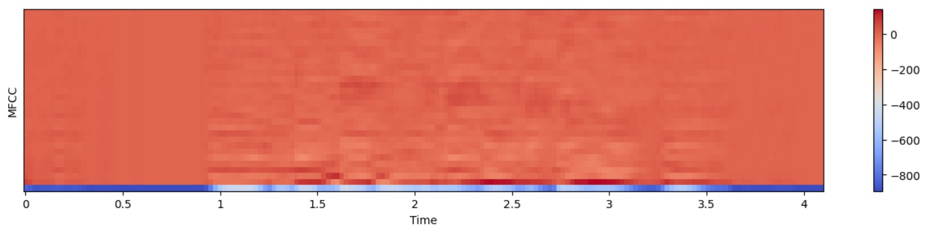
Methods of visualizing Audio data
MFCC Sample Image

Slide 21
Data Augmetation techniques for Audio data
Adding Noise Stretching Audio Shifting Audio Changing Pitch

Slide 22

Feature Extraction from Audio Data
Time Domain Features : ZCR (Zero Crossing Rate)
It measures the rate at which an audio signal changes its sign, indicating how many times the waveform crosses the horizontal axis (zero amplitude) within a given time frame
The zero crossing rate quantifies the number of times the amplitude of a signal transitions from positive to negative or vice versa.

Slide 23
Feature Extraction from Audio Data
Time Domain Features : ZCR (Zero Crossing Rate)
It serves as an indicator of the signal's smoothness and can provide insights into its tonal qualities.
Ex: voiced speech sounds tend to have lower ZCR values due to their smoother waveforms, while unvoiced sounds or noise exhibit higher ZCR values due to rapid fluctuations.

Slide 24
Feature Extraction from Audio Data
Time Domain Features :
RMS Energy (Root Mean Square Energy)
It is particularly useful for analyzing loudness, detecting speech segments, and assessing audio quality.
The RMS energy provides a measure of the average power of the audio waveform over time, making it a valuable feature for various applications, including speech recognition and emotion detection.

Slide 25
Feature Extraction from Audio Data
Perceptual Features :
Chroma STFT (Short term Fourier Transform)
Chroma features are based on the idea that music is often structured around 12 distinct pitch classes (the notes of an octave).
Instead of representing the full spectrum of frequencies, chroma features aggregate energy into these 12 bins, corresponding to each pitch class.

Slide 26
Feature Extraction from Audio Data
Perceptual Features :
MFCC (Mel-Frequency Cepstral Coefficients)
MFCCs capture the essential characteristics of an audio signal by mimicking human auditory perception.
A set of coefficients that represent the short-term power spectrum of sound, mapped to a scale approximating human auditory perception.
Used for speech and audio recognition, as it captures timbral information.

Slide 27
Feature Extraction from Audio Data
Perceptual Features :
Mel Spectorgram
It transforms audio signals into a time-frequency representation.
A set of coefficients that represent the short-term power spectrum of sound, mapped to a scale approximating human auditory perception.
It captures timbral information.

Slide 28
Implementing Sentiment Analysis on Audio Dataset

